Slide 1
UNIT-II
Divide-and-Conquer
Material prepared by
Dr. N. Subhash Chandra, Prof CSE.
Source: Web resources ,
Computer Algorithms by Sahni

Slide 2
Divide-and-Conquer: Syllabus
D and C concept and Applications
Binary Search,
Quick sort
Min-Max Problem
Topological sorting
Convex hull problem
DFS
BFS
Articulation points

Slide 3
Divide-and-Conquer
What is Divide-and-Conquer?
Divide: Divide the problem into a number of smaller sub-problems ideally of about the same size.
Conquer: The smaller sub-problems are solved, typically recursively. If the sub-problem sizes are small enough, just solve the sub-problems in a straight forward manner.
Combine: If necessary, the solution obtained the smaller problems are connected to get the solution to the original problem.

Slide 4
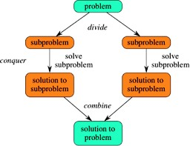
Divide-and-Conquer: Concept

Slide 5
Divide-and-Conquer: Control of Abstraction/ General Method
Algorithm DandC(p)
{
if small (p) then return S(p)
else
{
Divide P into small instances P1, P2, P3……..Pk, k≥1;
Apply DandC to each of these sub-problems;\
return combine (DandC(P1), DandC(P1),…. (DandC(Pk);
}
}

Slide 6
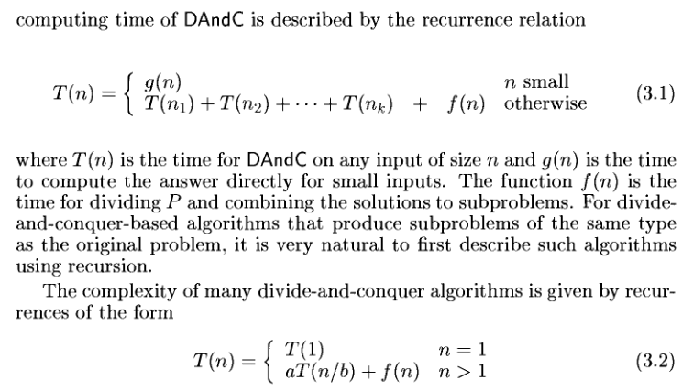
Divide-and-Conquer: Time Complexity

Slide 7
Application - Binary Search
Procedure
The method starts with looking at the middle element of the list. If it matches with the key element, then search is complete.
If the key element is less than the middle element, then the search continues with the first half of the list.
If the key element is greater than the middle element, then the search continues with the second half of the list.
This process continues until the key element is found or the search fails indicating that the key is not there in the list.

Slide 8
Contd ...
Example: -4, -1, 0, 5, 10, 18, 32, 33, 98, 147, 154, 198, 250, 500.
Sol: The given list of elements are:
Low
0 1 2
High
12 13 14
3
4
5
6 7 8 9 10 11
-4 | -1 | 0 | 5 | 10 | 18 | 27 | 32 | 33 | 98 | 147 | 154 | 198 | 250 | 500
Searching key '-1':
Here the key to search is '-1' First calculate mid;
Mid = (low + high)/2
= (0 +14) /2 =7
Low
0 1 2
Mid
6 7 8 9 10 11
High
12 13 14
3
4
5
-4 | -1 | 0 | 5 | 10 | 18 | 27 | 32 | 33 | 98 | 147 | 154 | 198 | 250 | 500
< First Half >
< Second Half >

Slide 9
Contd …
-1 < 32 Now mid = (0+6)/2 =3
High
4 5 6 7 8 9 10 11
Low
0 1 2
3
12 13 14
-4 | -1 | 0 | 5 | 10 | 18 | 27 | 32 | 33 | 98 | 147 | 154 | 198 | 250 | 500
Low 0 1 2 |  |  | Mid 3 | High 4 5 6 7 8 9 10 11 12 13 14
-4 | -1 | 0 | 5 | 10 | 18 | 27 | 32 | 33 | 98 | 147 | 154 | 198 | 250 | 500
< First Half >
< Second Half >
Low High
0 1 2 3
4 5 6 7 8 9
10 11
12
13 14
-4 | -1 | 0 | 5 | 10 | 18 | 27 | 32 | 33 | 98 | 147 | 154 | 198 | 250 | 500
-1 < 5 Now mid = (0+2)/2 =1
Low 0 | Mid 1 | High 2 3 4 5 6 7 8 9 10 11 12 13 14
-4 | -1 | 0 | 5 | 10 | 18 | 27 | 32 | 33 | 98 | 147 | 154 | 198 | 250 | 500
Here, the search key -1 is found at position 1

Slide 10
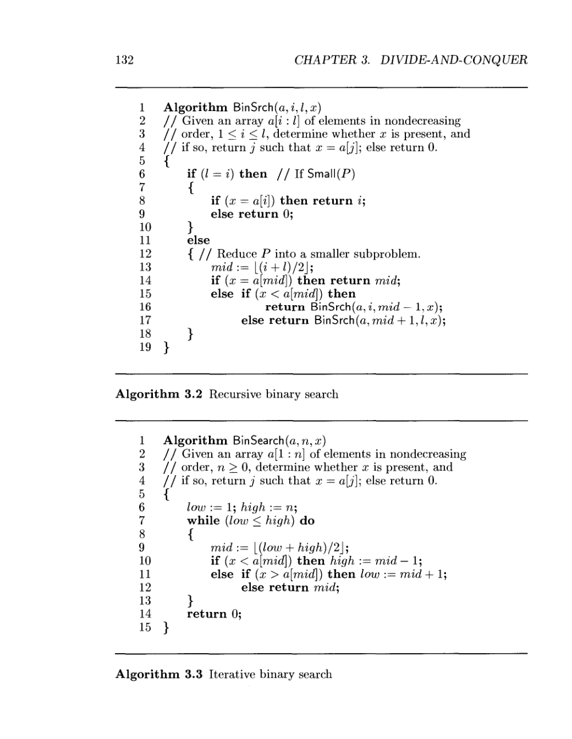
Application - Binary Search Algorithm

Slide 11
Application - Binary Search Algorithm

Slide 12
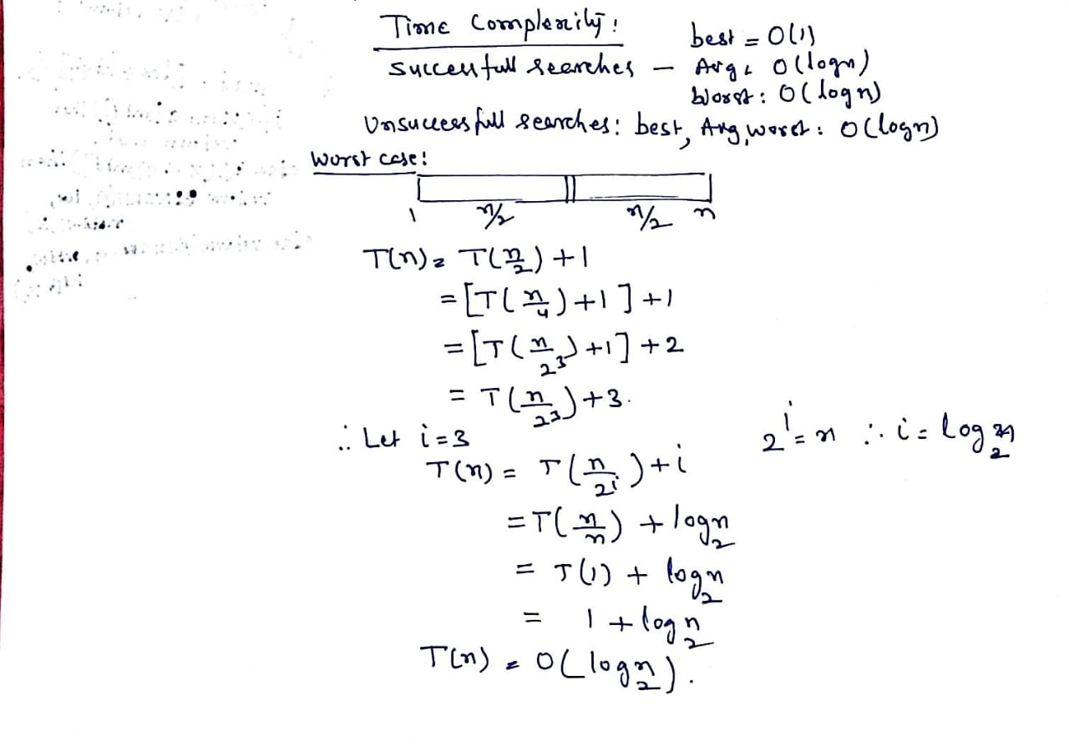
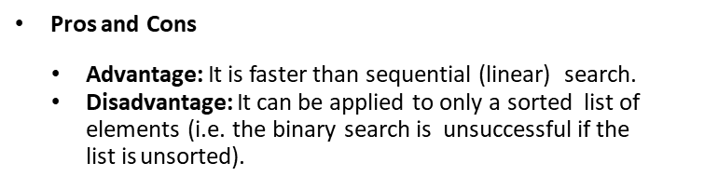
Time complexity of Binary Search

Slide 13
D and C Application: Quick Sort
Application - Quick Sort
The entire list is partitioned into two sub-list one of which holds values smaller than the specified value, say pivot, based on which the partition is made and another sub-list holds values greater than the pivot value.
Quick sort partitions an array and then calls itself recursively twice to sort the two resulting subarrays.

Slide 14
Example
Eg: 12 6 18 4 9 8 2 15
In this example, we use the first number, say 12, which is called the pivot (rotate) element.
Procedure
Let ‘i’ be the position of the second element and ‘j’ be the position of the last element. i.e. i =2 and j =8, in this example.
Assume that a [n+1] =∞, where ‘a’ is an array of size n.
i j
2 8
[1] | [2] | [3] | [4] | [5] | [6] | [7] | [8] | [9]
12 | 6 | 18 | 4 | 9 | 8 | 2 | 15 | α

Slide 15
Contd …
First scan the list from left to right (from i to j) can compare each and every element with the pivot. This process continues until an element found which is greater than or equal to pivot element. If such an element found, then that element position becomes the value of ‘i’.
Now scan the list from right to left (from j to i) and compare each and every element with the pivot. This process continues until an element found which is less than or equal to pivot element. If such an element finds then that element’s position become ‘j’ value.
Now compare ‘i’ and ‘j’. If i <j, then swap a[i] and a[j]. Otherwise swap pivot element and a[j].

Slide 16
Contd …
[1] | [2] | [3] | [4] | [5] | [6] | [7] | [8] [9] | i |  | j
12 | 6 | 18 | 4 | 9 | 8 | 2 | 15 α | 2 |  | 8
12 | 6 | 18 | 4 | 9 | 8 | 2 | 15 α | 3 |  | 7
12 | 6 | 2 | 4 | 9 | 8 | 18 | 15 α | 7 |  | 6
Since i = 7 j =6, then swap pivot element and 6th element ( j^{th} element), we get
8 6 2 4 9 12 18 15
Thus pivot reaches its original position. The elements on left to the right pivot are smaller than pivot (12) and right to pivot are greater pivot (12).
8 6 2 4
9 12 18 15
Sublist 2
Sublist 1
Now take sub-list1 and sub-list2 and apply the above process recursively, at last we get sorted list.

Slide 17
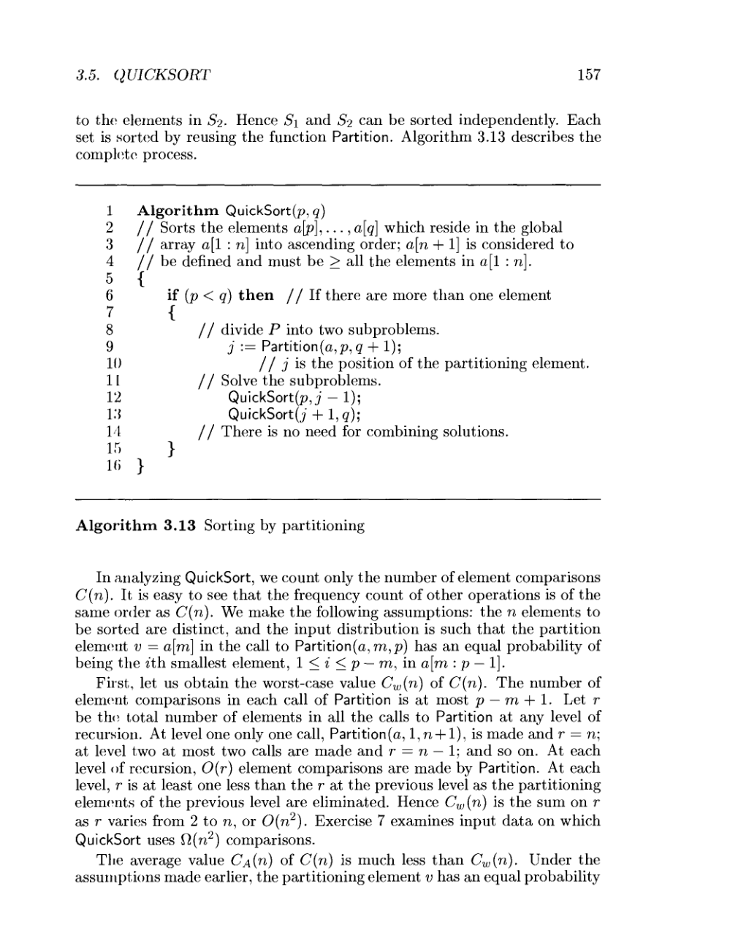
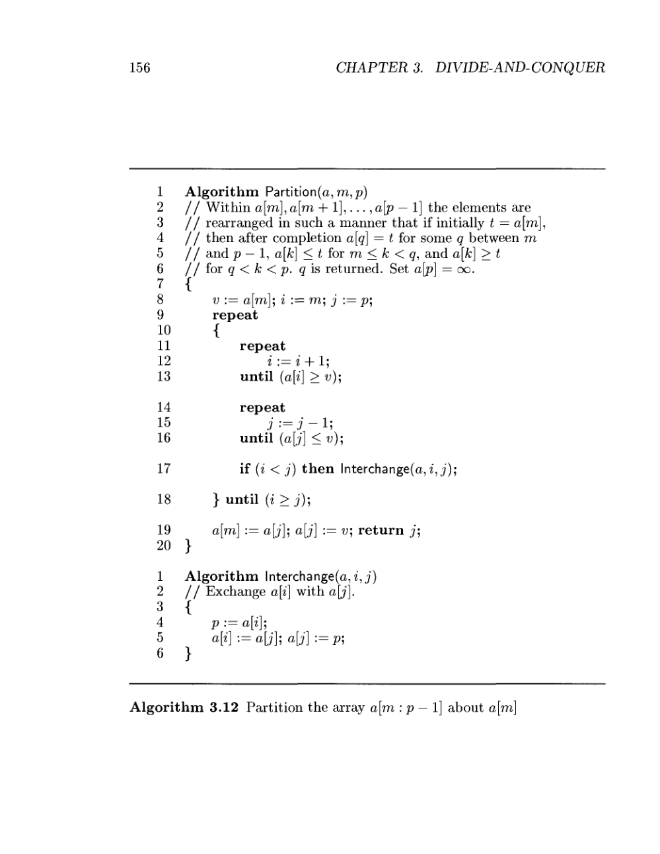
Application - Quicksort Algorithm

Slide 18
Application - Quicksort Algorithm

Slide 19
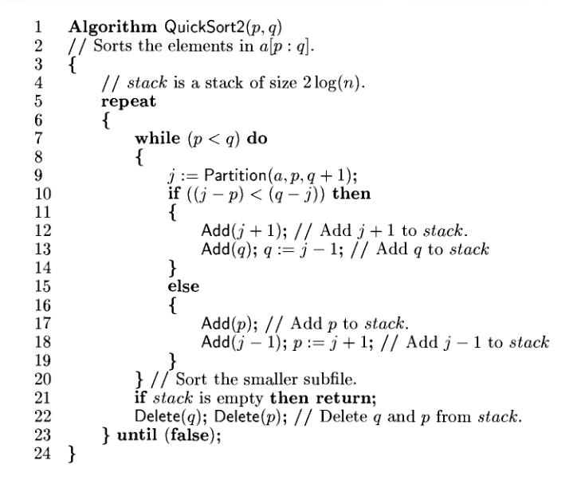
Application - Quicksort Algorithm

Slide 20
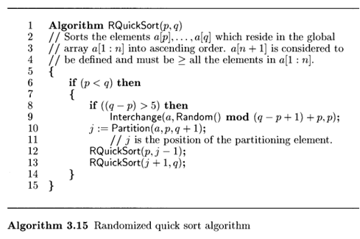
Application – Randomized Quicksort Algorithm

Slide 21
Application - Quicksort
Pros and Cons
Advantage: It is the fastest sorting method among all the sorting methods.
Disadvantage: It is somewhat complex and little difficult to implement than other sorting.

Slide 22
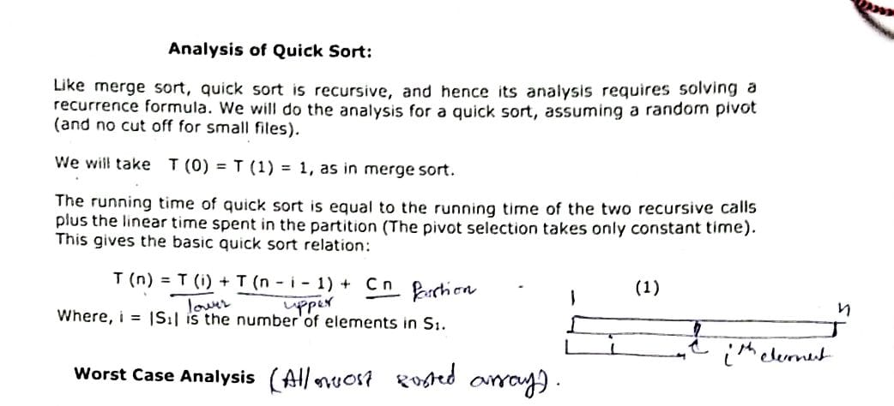
Application - Quicksort Algorithm : Time Complexity

Slide 23
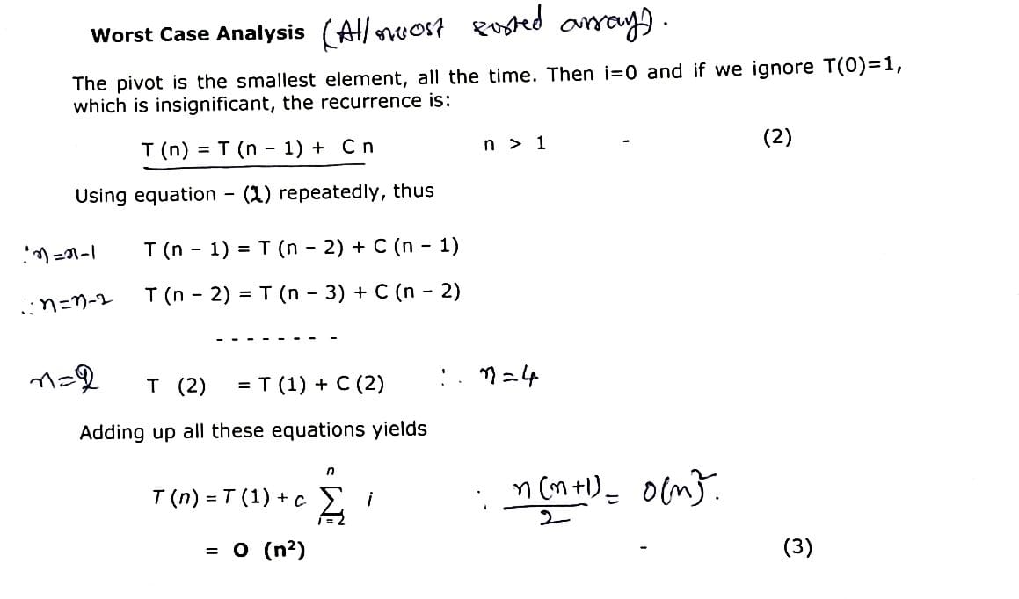
Application - Quicksort Algorithm : Time Complexity

Slide 24
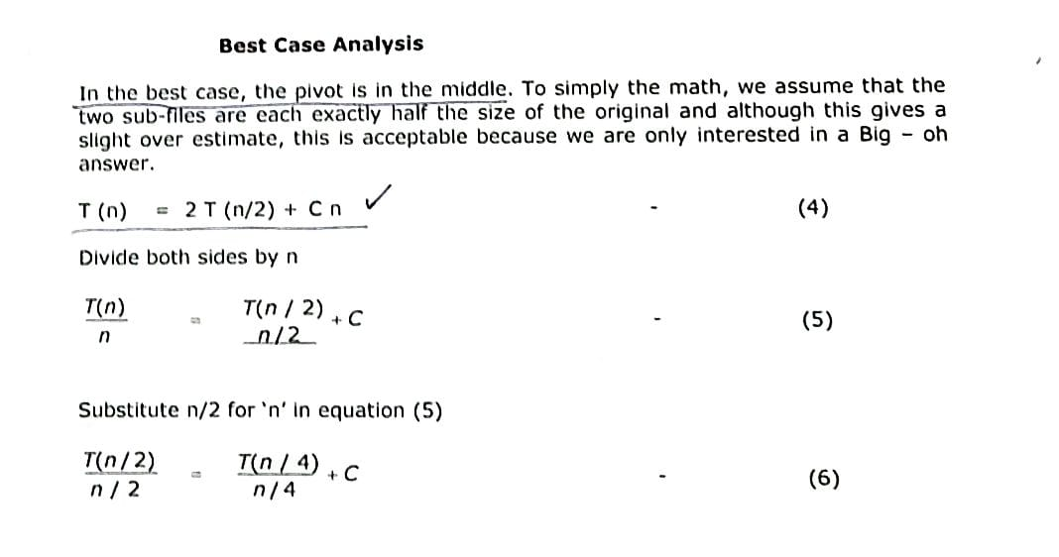
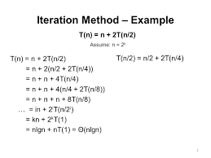
Application - Quicksort Algorithm : Time Complexity

Slide 25
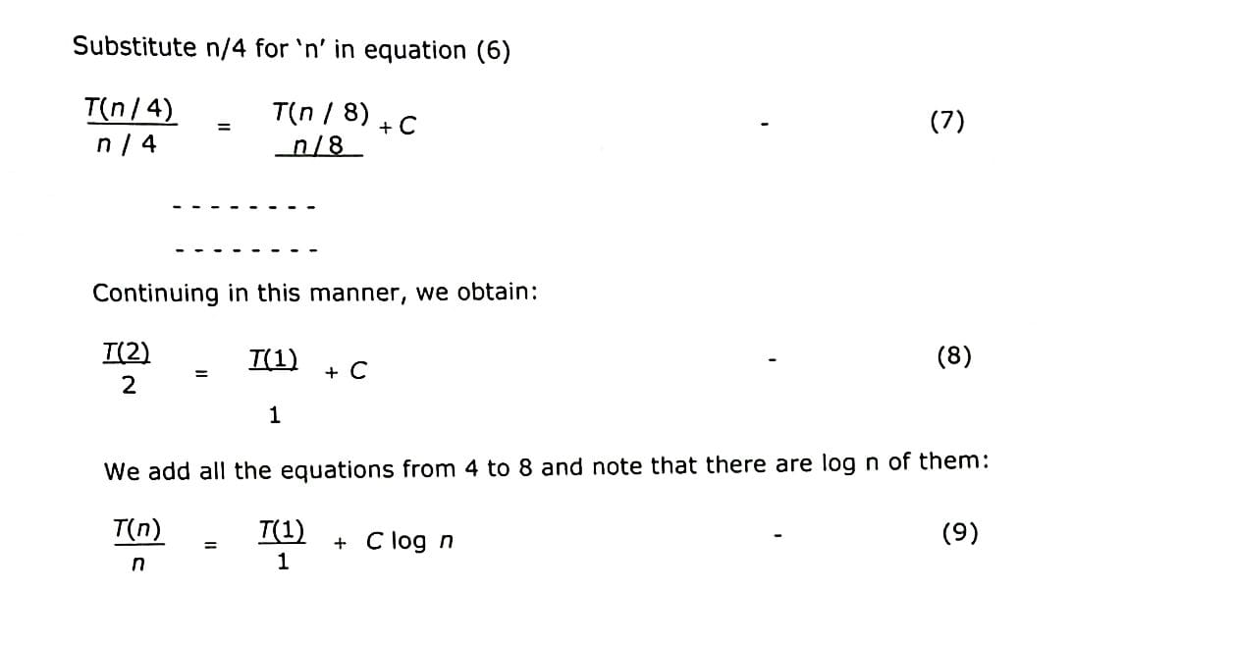
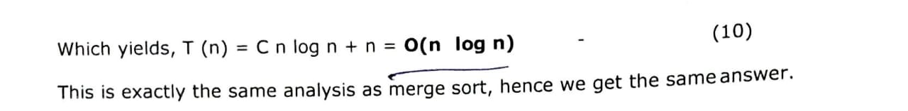
Application - Quicksort Algorithm : Time Complexity

Slide 26
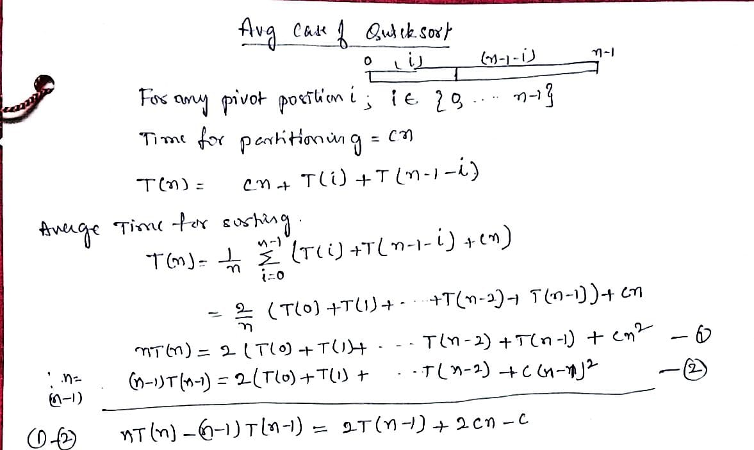
Application - Quicksort Algorithm : Time Complexity

Slide 27
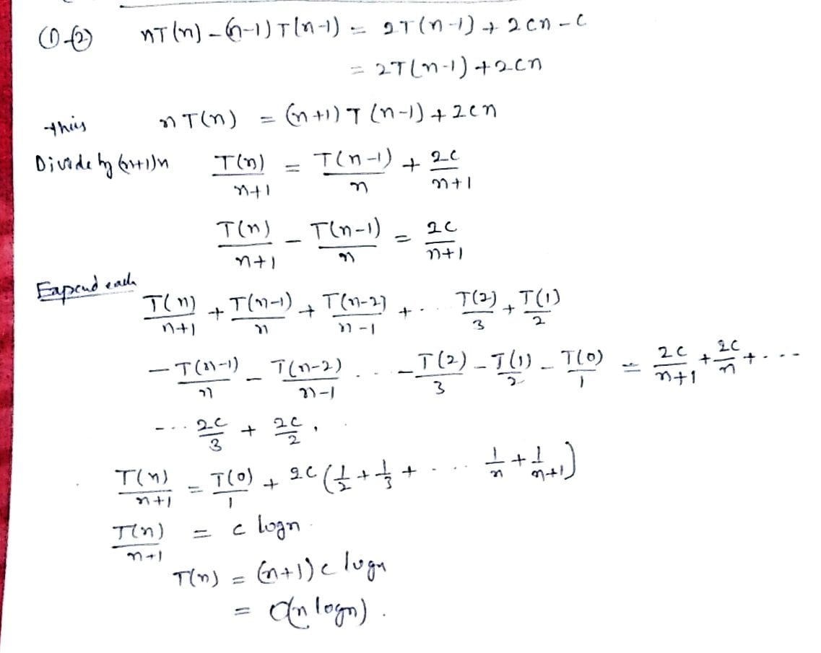
Application - Quicksort Algorithm : Time Complexity

Slide 28
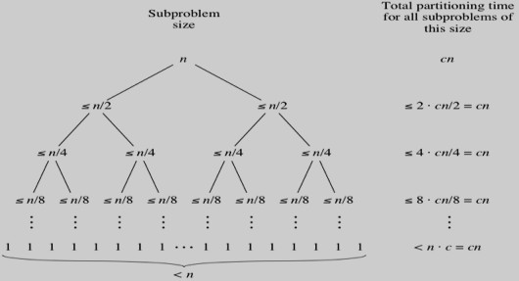
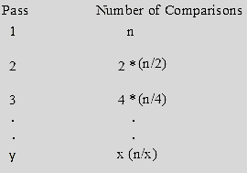

Application - Quicksort Algorithm : Time Complexity-Recursion tree method
Best Case: In best case, consider the following two assumptions-
The pivot, which we choose, will always be swapped into the exactly the
middle of the list. And also consider pivot will have an equal number of elements both to its left and right.
The number of elements in the list is a power of 2 i.e. n= 2^{y}
.

Slide 29
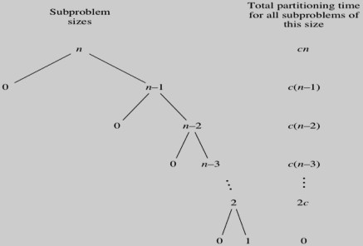
Contd…..
Worst Case: Assume that the pivot partition the list into two parts, so that one of the partition has no elements while the other has all the other elements.

Slide 30
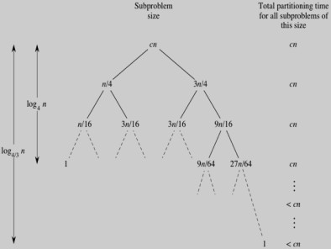
Contd…..
Average Case: Assume that the pivot partition the list into two parts, so that one of the partition has no elements while the other has all the other elements.
Quick Sort
Best Case | O(n log n)
Average Case | O(n log n)
Worst Case | O(n²)

